Slide 1
AI IN FINANCIAL SERVICES
DEFECT DETECTION FOR LAPTOPS
Industry Mentor
Manu Sharma
Hewlett Packard Enterprise(HPE)
Gayathri R 22i218
Vinithaa P 22z273
Kiruthika Sermadurai 22z336
Sanjitha R 22z259
Durga G 22z321
Academic Mentor
Dr.Suriya S
CSE Department
PSG College of Technology

Slide 2
OBJECTIVE
Develop a vision-based system that can automatically detect defects in laptop devices.
Reduce the manual inspection efforts and minimize the human error.
Ensures the quality assurance of the laptops.
Streamline the inspection process to ensure only high-quality laptops are approved for use.

Slide 3
USE CASE
Defect Detection Before Leasing: Laptops are visually inspected before being leased. Ensures only quality-approved devices are circulated.
Post Leasing Condition Check: Laptops are re-inspected when returned after leasing. Helps to detect any new changes caused during lease.
Pre-shipment Inspection for Online Orders: Used to detect any visible defects before packing and shipping laptops ordered online.

Slide 4
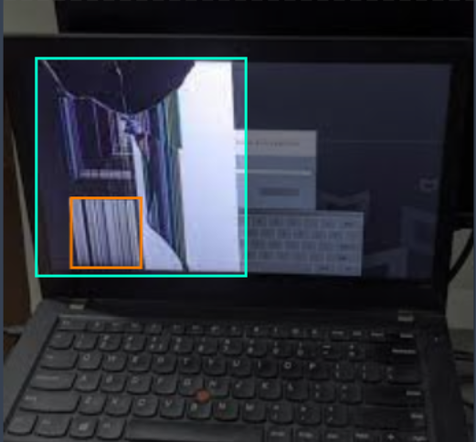
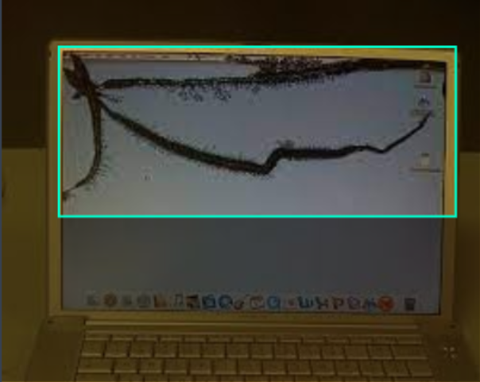
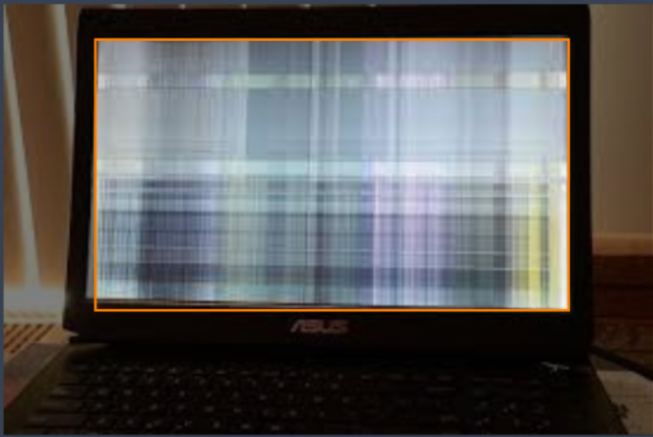
DATASET :
https://universe.roboflow.com/team-ks/broken-laptop-parts/images/
Also collected images from Amazon, Flipkart

Slide 5
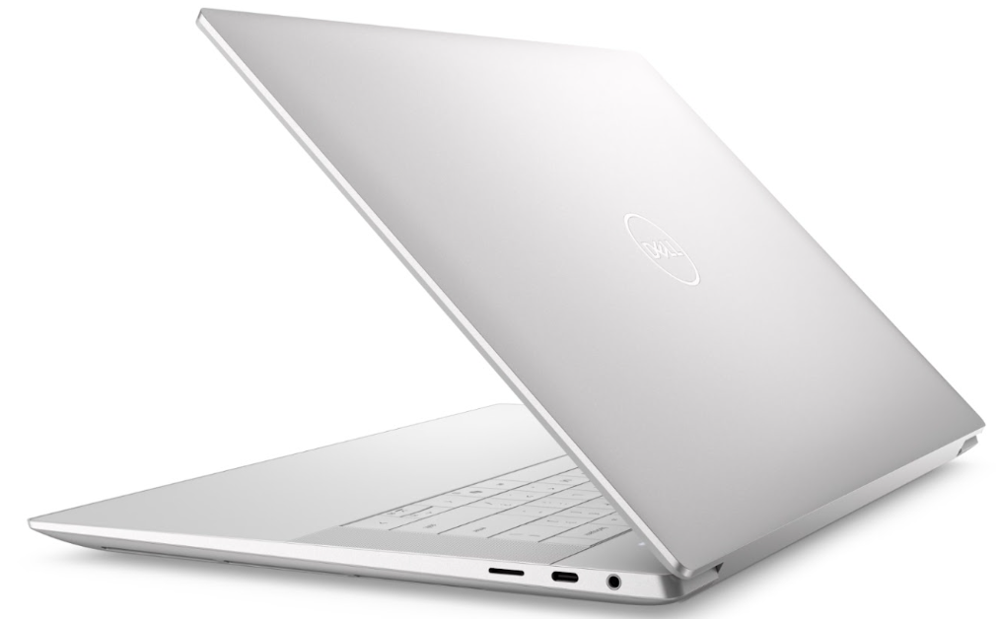
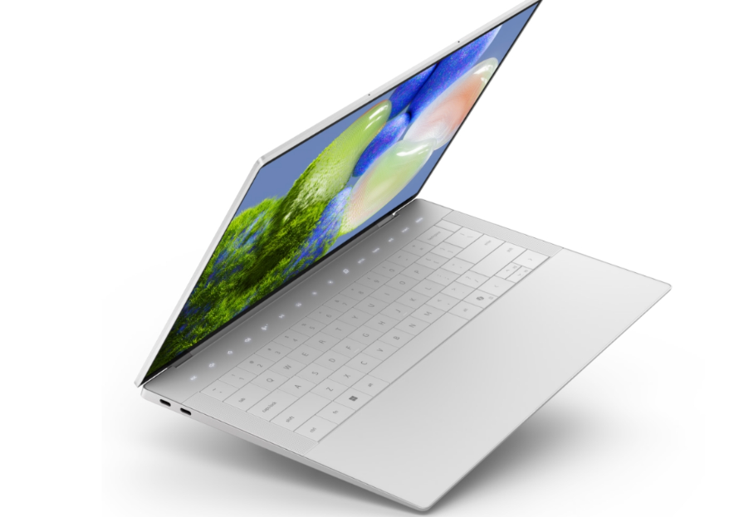
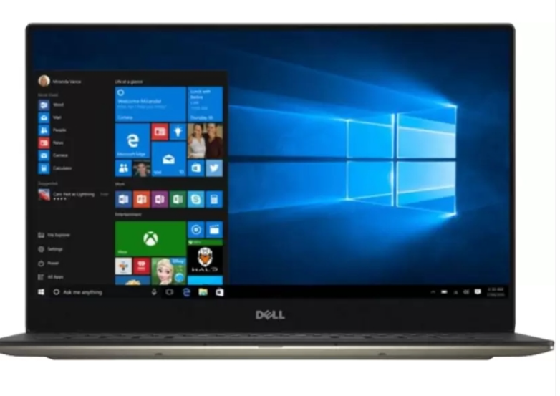
DATASET :
Dataset from kaggle that has images of laptops:
https://www.kaggle.com/datasets/sugxm00/laptop-dataset

Slide 6
DATASET :
Defectless samples : 532
Defective samples : 298
Dataset splitting
Data split (Train: 70%, Validation: 20%, Test: 10%)

Slide 7
Importance of Data Quality in Model’s performance
Accurate Labels: Ensures the model learns from correct associations and avoids errors.
Clear Images: High-quality images help the model capture key features, reducing ambiguity.
Consistent Data: Standardized backgrounds, angles, and lighting ensure the model focuses on relevant features (defects, not noise).
Balanced Dataset: Prevents bias, ensuring the model doesn’t overfit to the majority class.

Slide 8
Importance of Data Standardization
Image Resizing: Ensures uniform input for the model, preventing shape mismatches.
Pixel Scaling: Normalizing pixel values speeds up learning and prevents the model from being influenced by variable intensity.
Color Adjustments: Standardized lighting conditions allow the model to focus on important features, not environmental variations.
Data Augmentation: Expands the training set, helping the model generalize better and avoid overfitting.

Slide 9
Preprocessing Techniques Used
Image Resizing
All images resized to 224×224 pixels for uniform input size.
Random Horizontal Flip
50% chance to flip image horizontally to increase variation.
Brightness & Contrast Adjustment
Applied using ColorJitter with controlled variation:
Brightness: 85% – 115%
Contrast: 85% – 115%
Random Rotation
Image rotated randomly by 0°, 90°, 180°, or 270°

Slide 10
Models Used
MobileNetV2
A lightweight model optimized for speed and efficiency, ideal for real-time defect screening on mobile and embedded devices.
ResNet-50
A deep learning model with 50 layers that helps accurately detect defects by learning from complex patterns in images.
Yolov8
A fast and reliable object detection model that uses bounding boxes to clearly show defect areas, providing quick, trustworthy results in real-time.

Slide 11
MobileNetV2
MobileNetV2 is a small and fast model that helps in image classification. It’s designed to work well on phones and other small devices, where speed and saving battery are important.
Why MobileNetV2?
Quick checks
Low power needs
Compact
High accuracy in defect detection

Slide 12
MobileNetV2
How We Used It:
Used pre-trained MobileNetV2.
Adjusted it for defect detection with custom images.
Modified the model to output "defect" or "no defect."
Added dropout layers to prevent overfitting.
Designed for fast and efficient defect detection.
Extra Benefit:
It can be used in real-time during production, helping catch issues early.

Slide 13
ResNet-50
A deep learning model with 50 layers that helps accurately detect defects by learning from complex patterns in images.
Why ResNet-50?
Captures intricate details
Learns better
Trusted in the industry
High accuracy in defect detection

Slide 14
ResNet-50
How We Used It:
Pre-trained ResNet-50
Custom Ending for Application
Data Augmentation (flipping, rotating)
Improved Flexibility and Accuracy
Extra Benefit:
Great for final quality checks where accuracy really matters.

Slide 15
Yolov8
A fast and reliable object detection model that uses bounding boxes to clearly show defect areas, providing quick, trustworthy results in real-time.
Why Yolov8?
Lightweight
Fast and accurate
Bounding box for trust

Slide 16
Yolov8
How We Used It:
Uses Labeled Images with Bounding Boxes
Defect Presence = Bounding Box Detected
No Defect = No Bounding Box
Highlights Defective Areas
Enhances User Trust and Interpretability
Extra Benefit: It builds trust, users can see where the defect lies.

Slide 17
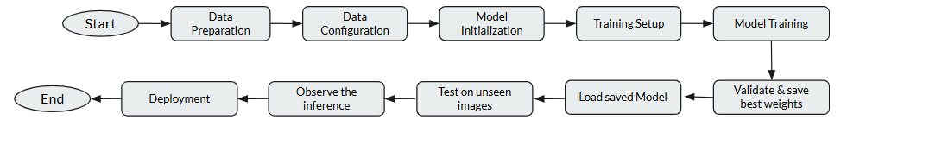
WorkFlow

Slide 18
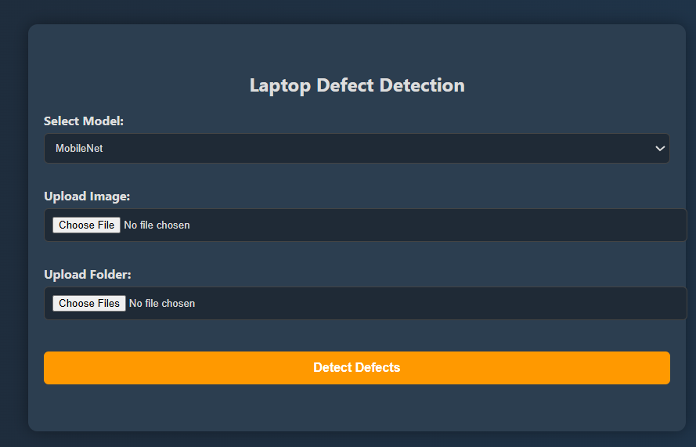
User Interface for Laptop Defect Detection

Slide 19
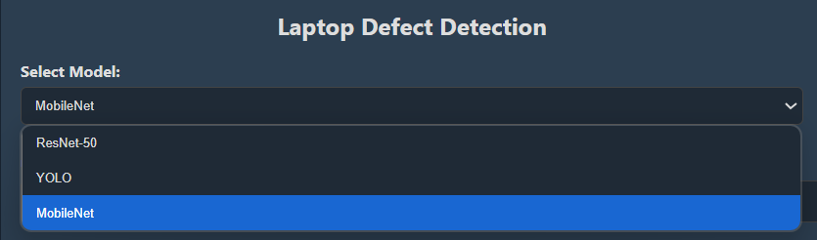
Model Selection
It offers options to choose between three different models.

Slide 20
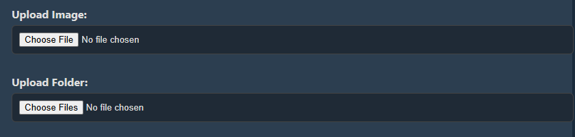
Single Image and Folder Uploading

Slide 21
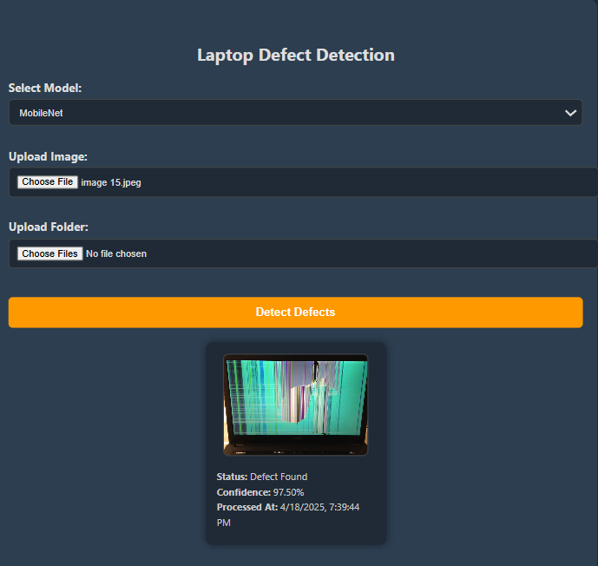
Uploading a Single Image
MobileNetV2 Model

Slide 22
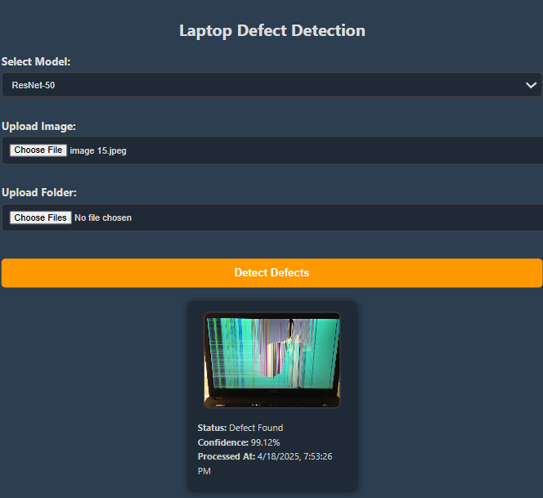
ResNet-50 Model

Slide 23
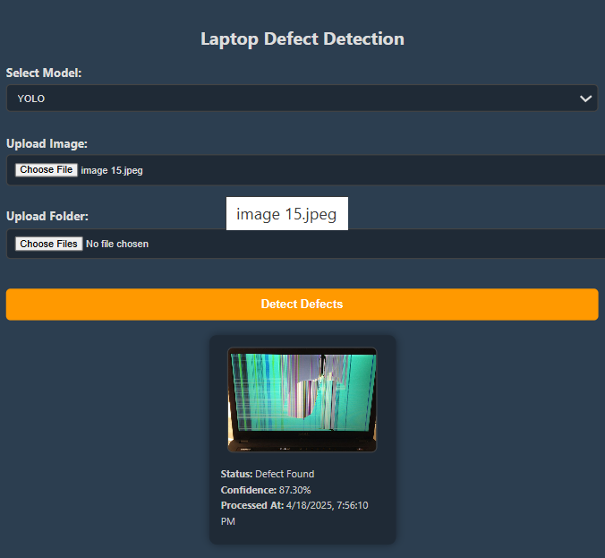
YOLO (You Only Look Once) Model

Slide 24
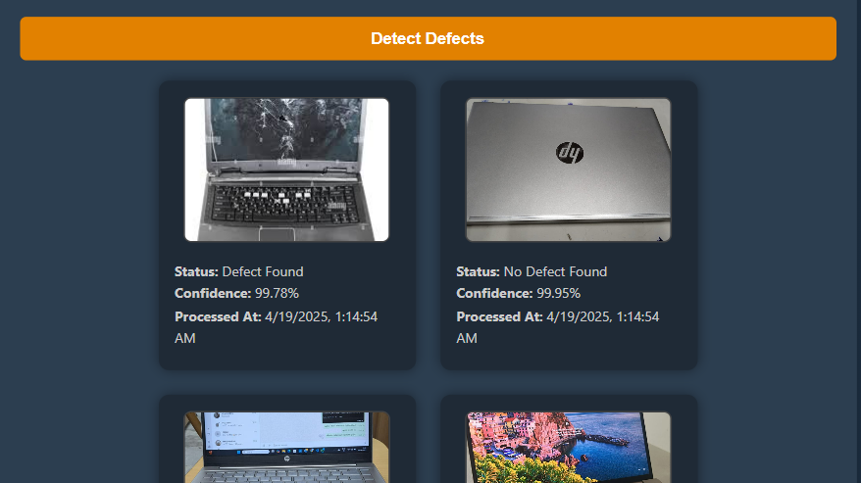
Uploading a Folder
MobileNetV2 Model

Slide 25
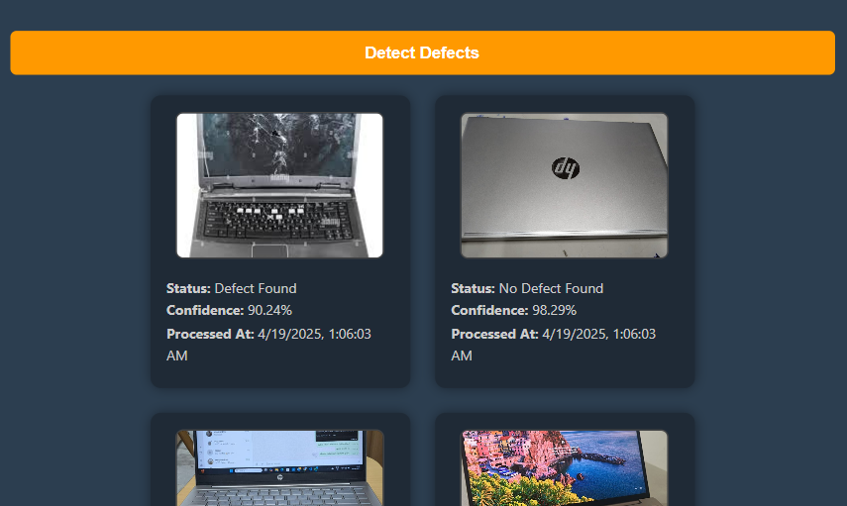
Resnet-50 Model

Slide 26
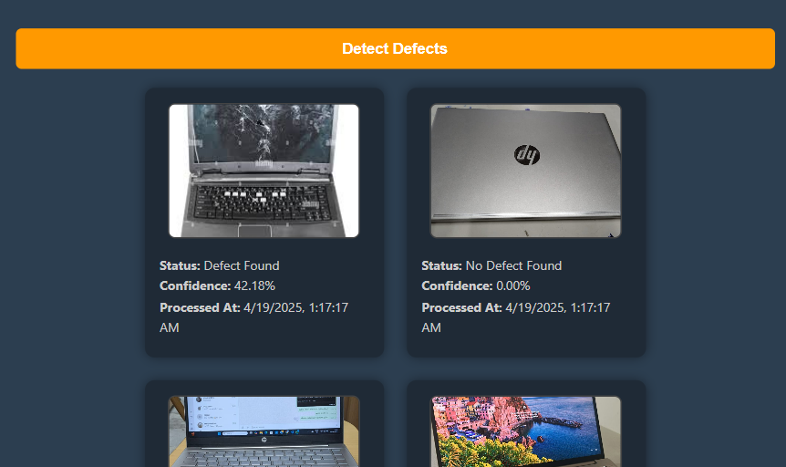
YOLO (You Only Look Once) Model

Slide 27
CHALLENGES FACED
Dataset Collection: Collecting a large, diverse dataset was time-consuming, and varying image resolutions affected model performance.
Model Selection: We experienced overfitting and low accuracy with ResNet18 and EfficientNet.
UI Model Integration: Integrating models was challenging due to differing image preprocessing requirements, ensuring smooth user interaction.
Web deployment: Faced port errors and frequent downtime on Render.com; stable performance required a premium plan.

Slide 28
DEPLOYMENT PLAN
Render – Free full-stack deployment (Flask + React) with GitHub auto-deploy and HTTPS support.
Railway (Free Tier) – Full-stack hosting for Flask and React with GitHub CI/CD, environment support, and HTTPS.

Slide 29
PLANNED IMPROVEMENTS
Device Generalization – Extend the system to support smartphones and tablets by fine-tuning models for different devices and defects.
Annotation Feedback Loop: Enable users to correct inaccurate predictions, using the updated data to retrain and improve model performance.

Slide 30
THANK YOU

